Slide 1
FLEXIFAAS - Serverless Function Deployment Engine
CSIW ZG628T DISSERTATION
BIRLA INSTITUTE OF TECHNOLOGY AND SCIENCE
Pilani (Rajasthan) India
Name: Abid Rafique Khan
BITS ID: 2021WA86438
SUPERVISOR: AYUSH RANJAN

Slide 2
Introduction
Build a secure platform for uploading and running custom code (functions) in the cloud
Focus on scalability, security, and async processing
Implemented using Java, Spring Boot, MySQL, RabbitMQ
End goal: real-world, flexible, cloud-native system

Slide 3
Area of Research
Cloud-native applications need flexible, on-demand execution
Serverless/FaaS offers cost savings, scalability, and speed
Existing solutions are complex or expensive
Goal: Build a simple, self-hosted platform

Slide 4
Objectives
Allow secure function upload (JavaScript, Python, Java)
Store, manage, and execute user functions on demand
Use RabbitMQ for async and scalable execution
Log every execution for auditing and feedback
Make APIs developer-friendly and robust

Slide 5
Scope of Work
In Scope: Backend APIs, secure storage, execution engine, message queuing, basic UI (future)Store, manage, and execute user functions on demand
Out of Scope: Deep cloud integration, billing, multi-tenancy

Slide 6
Literature Review
Serverless/FaaS saves costs, speeds up development (Jonas et al. 2019)
Async messaging (RabbitMQ) critical for scale (Spillner et al. 2017)
Custom FaaS platforms can be tailored for specialized needs
Security and function isolation is an ongoing challenge

Slide 7
Methodology
Stack: Java, Spring Boot, MySQL, RabbitMQ, Hibernate, Maven
Method:
Backend + DB setup
Entity/service/repository layer
Function upload & execution APIs
Async execution with RabbitMQ
Logging and error handling

Slide 8
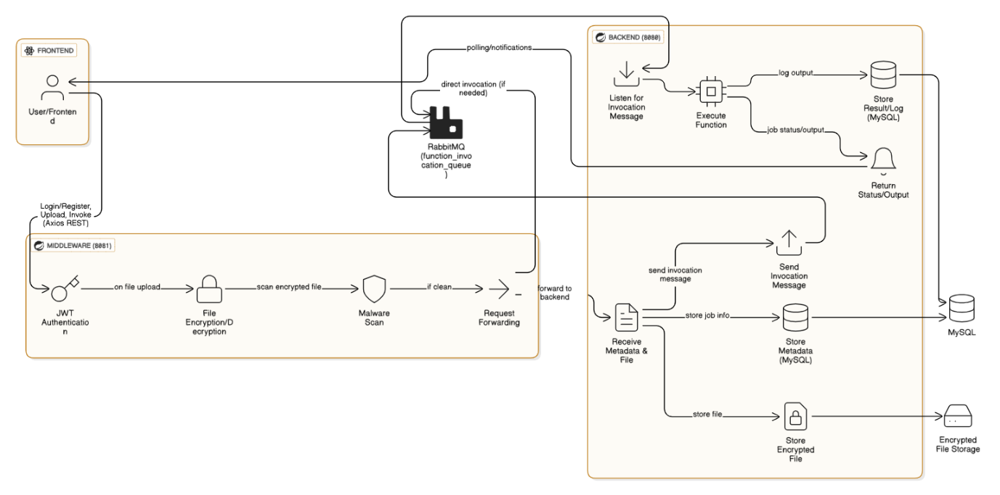
System Architecture Diagram

Slide 9
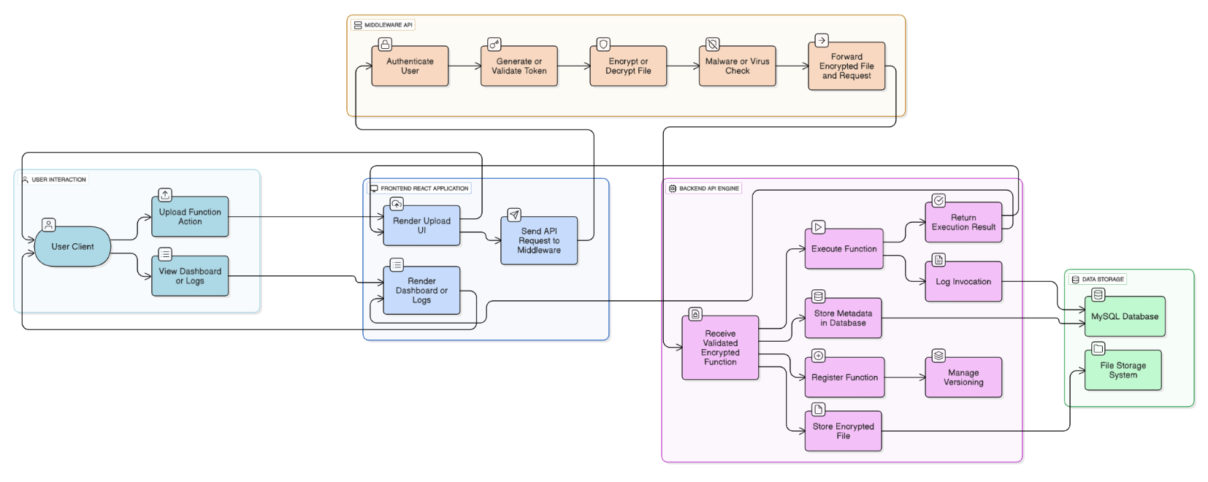
High Level Diagram

Slide 10
Plan of Work
Week | Work | Status
1 | Tools and architecture Finalized | Completed
2 | Backend Set up with MySQL | Completed
3 | Entities, Services, Repositories Defined, CRUD applied | Completed
4 | Endpoints created for function | Completed
5 | Simulated Execution using Postman | Completed
6 | RabbitMQ integration | Completed
7 | Configure, test queue setup | Completed
8 | Refactor send function invocation to RabbitMQ queue | Completed
Upcoming: Security middleware, encryption, frontend, full integration

Slide 11
Key Features Implemented
Upload function (file or code)
Execute function with input
Execution logs saved to DB
Async job queue using RabbitMQ

Slide 12
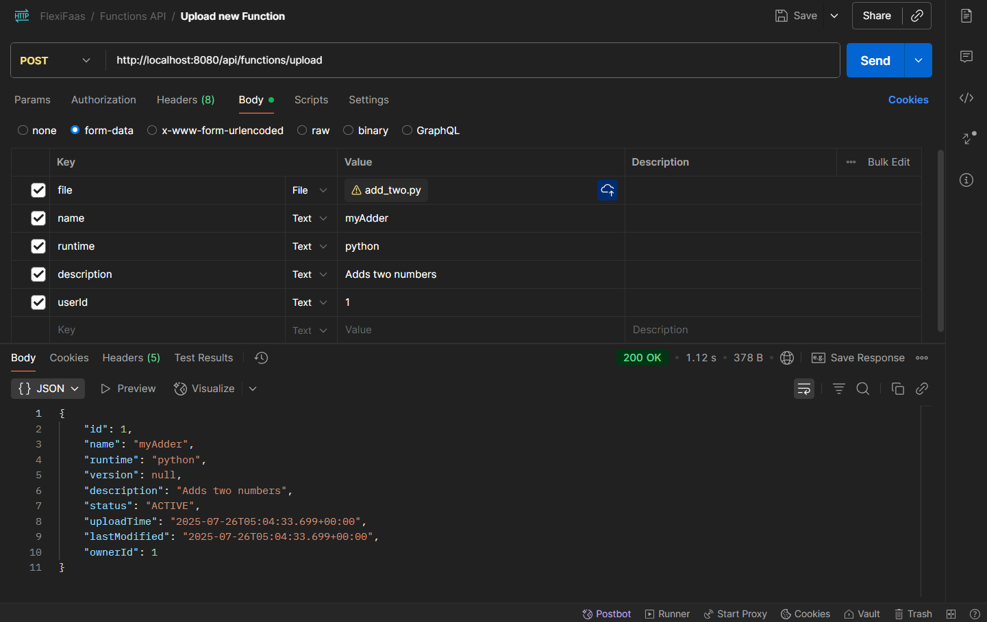
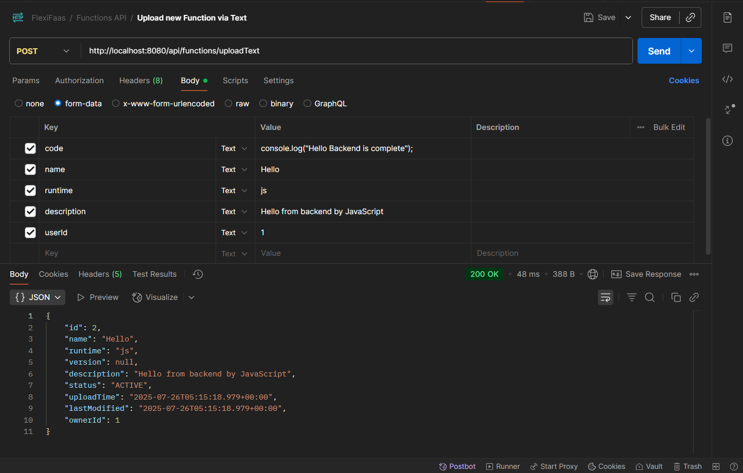
API Testing
API test for uploading a new function with file using POST /api/functions/upload
API test for uploading a new function by source code using POST /api/functions/uploadText

Slide 13
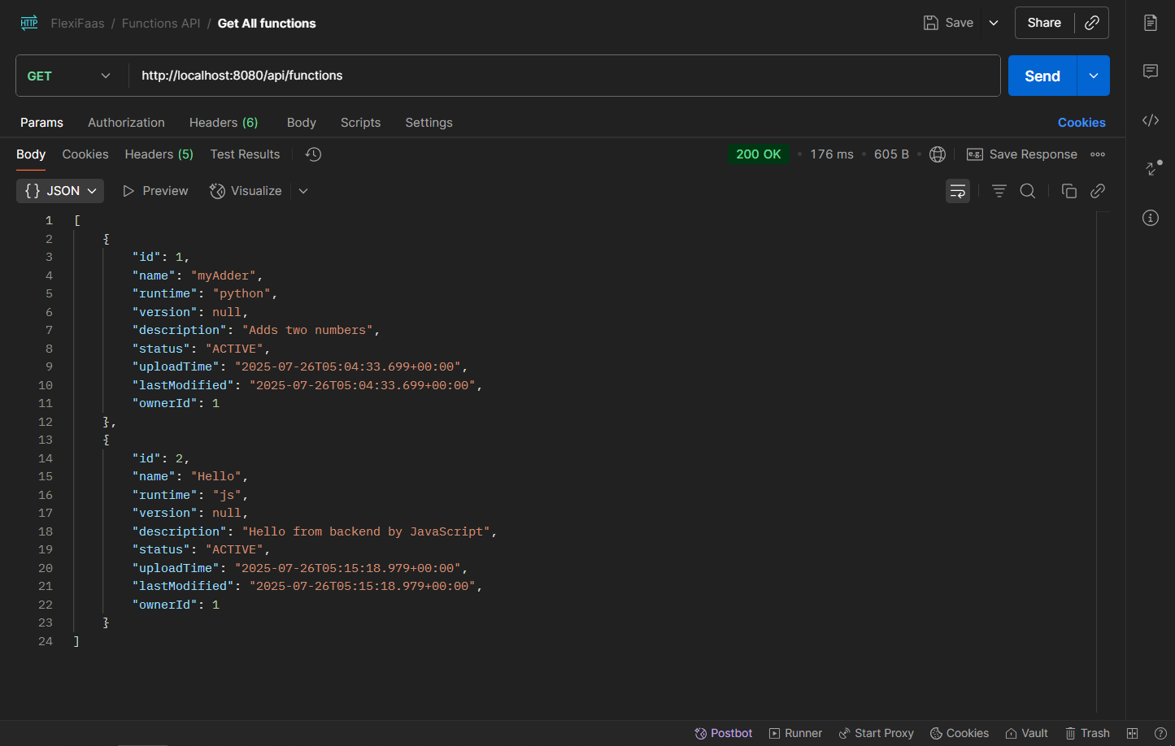
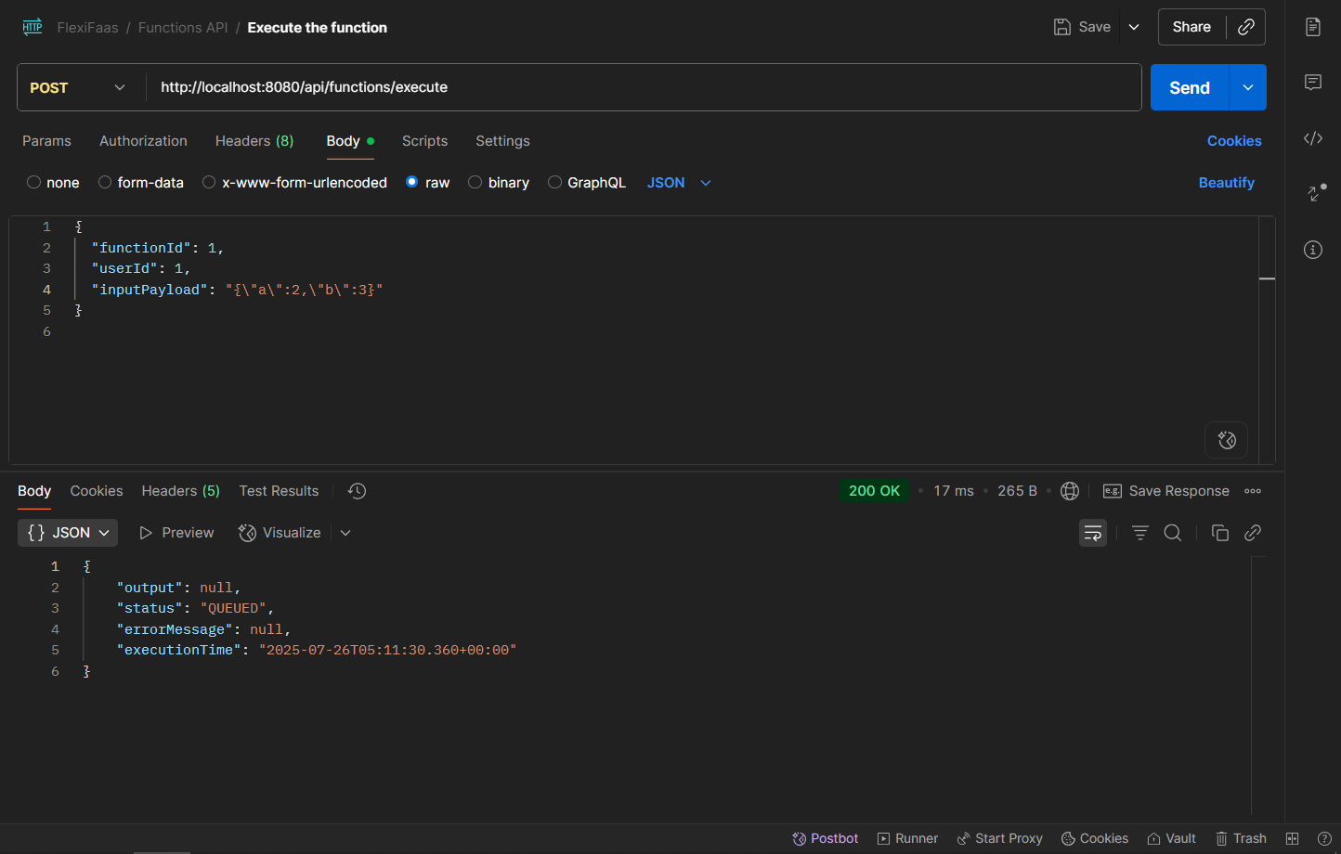
API Testing
API response for retrieving all registered functions with GET /api/functions
API call to execute a function with input payload using POST /api/functions/execute

Slide 14
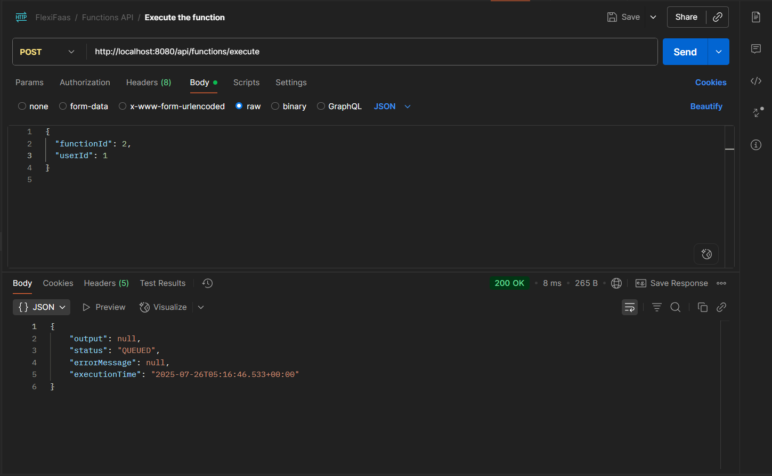
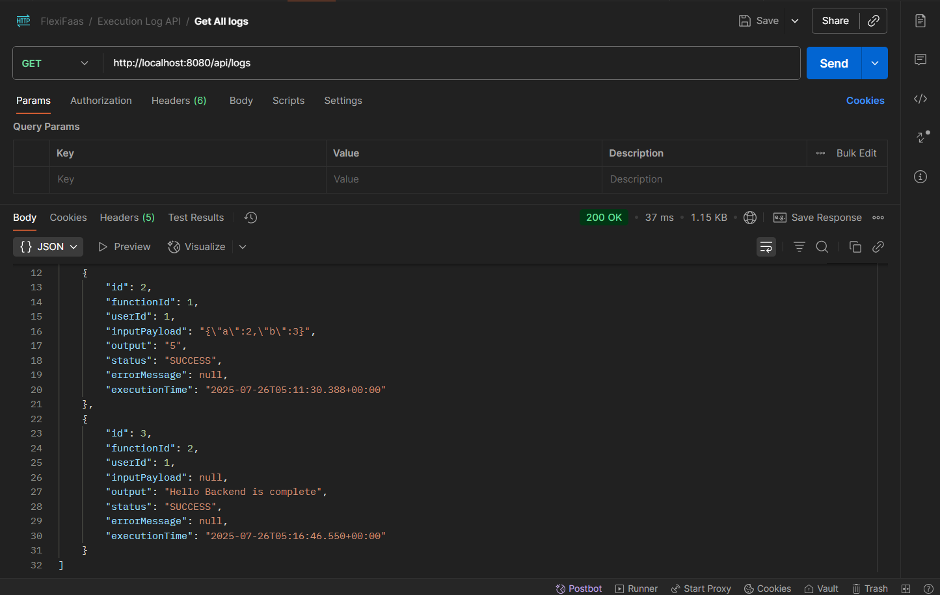
API Testing
API call to execute a function without input payload using POST /api/functions/execute
API call to fetch all function execution logs with GET /api/logs

Slide 15
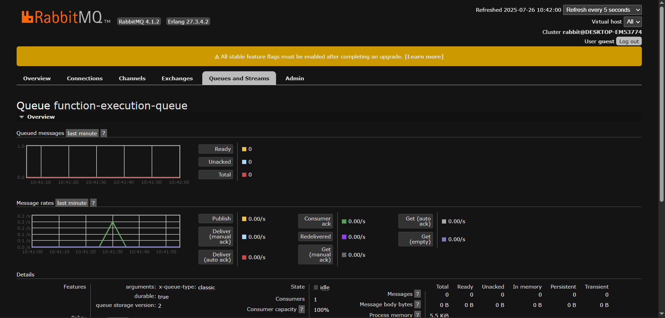
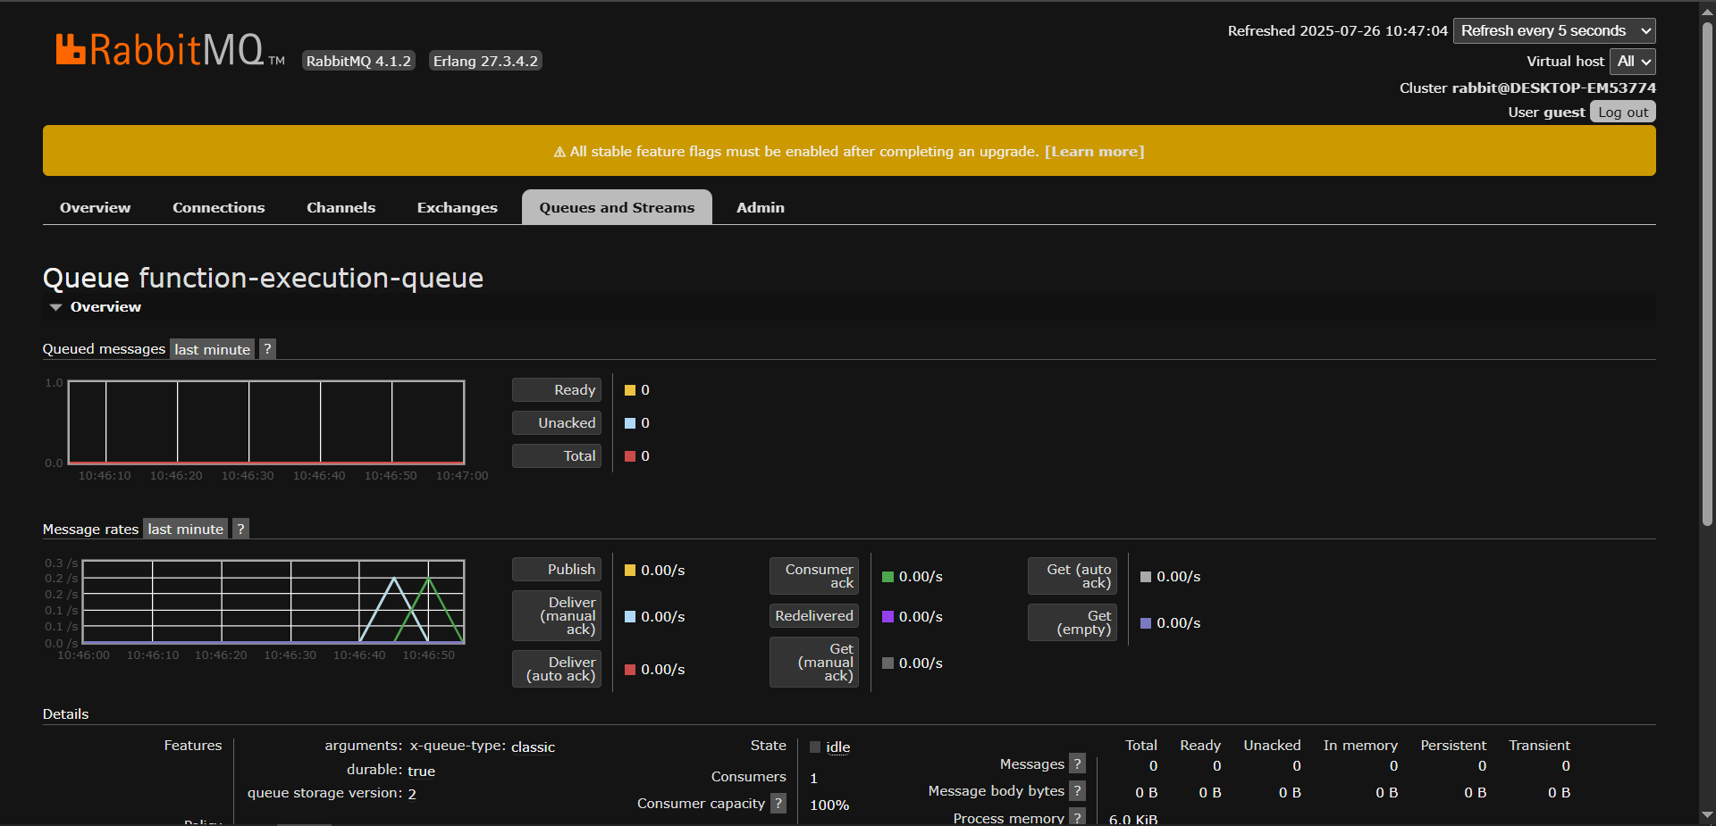
RabbitMQ & Logs
RabbitMQ management UI showing message queue activity for function-execution-queue
RabbitMQ management UI confirming queue status after execution

Slide 16
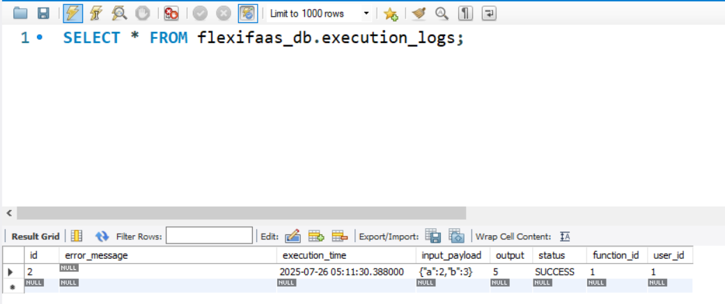
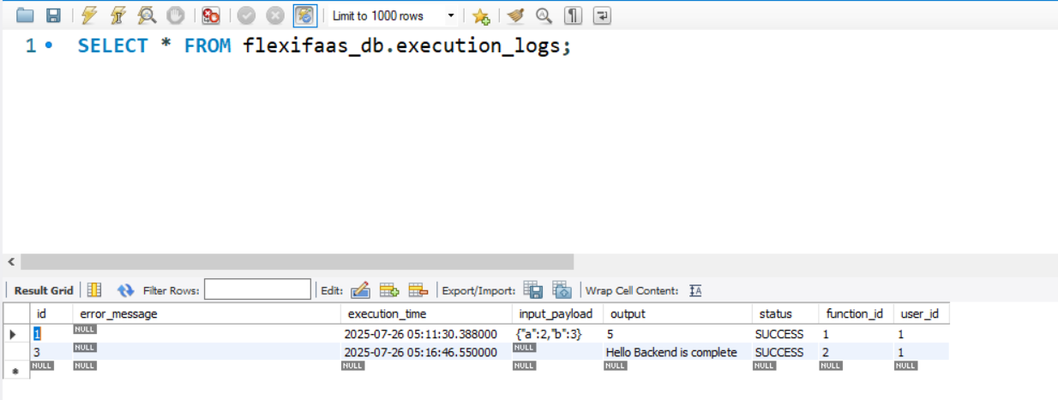
RabbitMQ & Logs
Execution log entry stored in MySQL database after function execution
Another sample execution log entry in MySQL database

Slide 17
Challenges & Learnings
Setting up async messaging
Managing file uploads
Troubleshooting function execution (Python/Java/JS)
Understanding cloud-native patterns

Slide 18
Roadmap
Build middleware (JWT auth, file encryption)
Malware scanning (if time permits)
Develop React frontend
System integration & user testing

Slide 19
Thank you! Questions?

